Slide 1
Learning the k in k means
Presenter: Johnny Lee, Frank Zhao

Slide 2
Quick refresher on k means
A popular approach to clustering
Divides n data samples into k number of partitions iteratively according to some measurement threshold.
We need to specify a k
Notes:
How does K means work?

Slide 3
Problem: how to determine k?
A hard problem
Often no obvious answer
Even harder when many dimensions are involved
Generally an ad hoc decision based on prior knowledge / assumptions about the data
Relies on heuristics and ”human intuition”
Can we automatically estimate the k value?

Slide 4
Previous approach
X means
Searches many k values, the rank the score using Bayesian Information Criterion (BIC)
Minimum description length method
Deductive: uses large values for k and reduce k if the choice reduces description length
Other hierachical, dendrogram based methods
Requires domain-specific knowledge and human intuition

Slide 5
G means
This paper’s contribution
A method to automatically estimate the k value.
Key idea:
Hypothesis: a subset of data should follow a Gaussian distribution
Runs k-means with increasing k in hierarchical fashion until subset meets hypothesis
At each step, run a statistical test to see if the subset is Gaussian
Notes:
--What if it doesn’t follow Gaussian distribution (Can we run experiments?)

Slide 6
How does it work?
The algorithm:
start with a small number of k-means centres, and increase them
Each iteration split a centre into 2 if the data does not appear to fit a Gaussian distribution
Run k means on global dataset between each iteration
How do we know whether the data is Gaussian?
Use a statistical test to verify–in this case, Anderson-Darling statistic

Slide 7
A step by step example
Source: bigml.com

Slide 8
Source: bigml.com

Slide 9
Source: bigml.com

Slide 10
Source: bigml.com

Slide 11
Benefits of G means
Only requires one intuitive parameter
alpha rate, which is the confidence level of the statistical test
Efficiency:
Low computation cost, does not compute full covariance matrix

Slide 12
Experimentations :X-means vs G-means
Round 1 : Clustering spherical data
Both X-means and G-means perform equally well
But real world data is often not spherical (!)

Slide 13
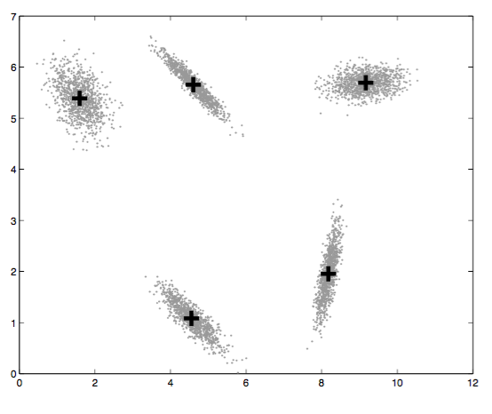
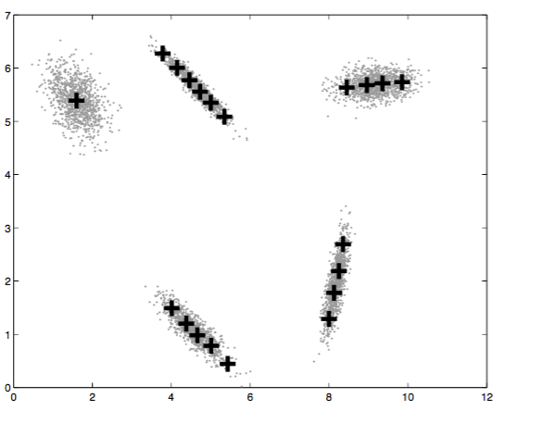
Round 2: Non-spherical dataset
G means performs better in non-spherical data
X-means tend to over fit the data

Slide 14
Round 3: dealing with high dimensions
Efficiency / scalability:
X means is faster than G-means in low dimensions, but has poor scalability
When d > 8, X means becomes very slow
G means speed does not increase significantly with dimensions
Accuracy
Tested on NIST, and handwriting dataset
G means found 31 clusters in 30 seconds
X means found 715 clusters in 4149 seconds, 369 contained only 1 point

Slide 15
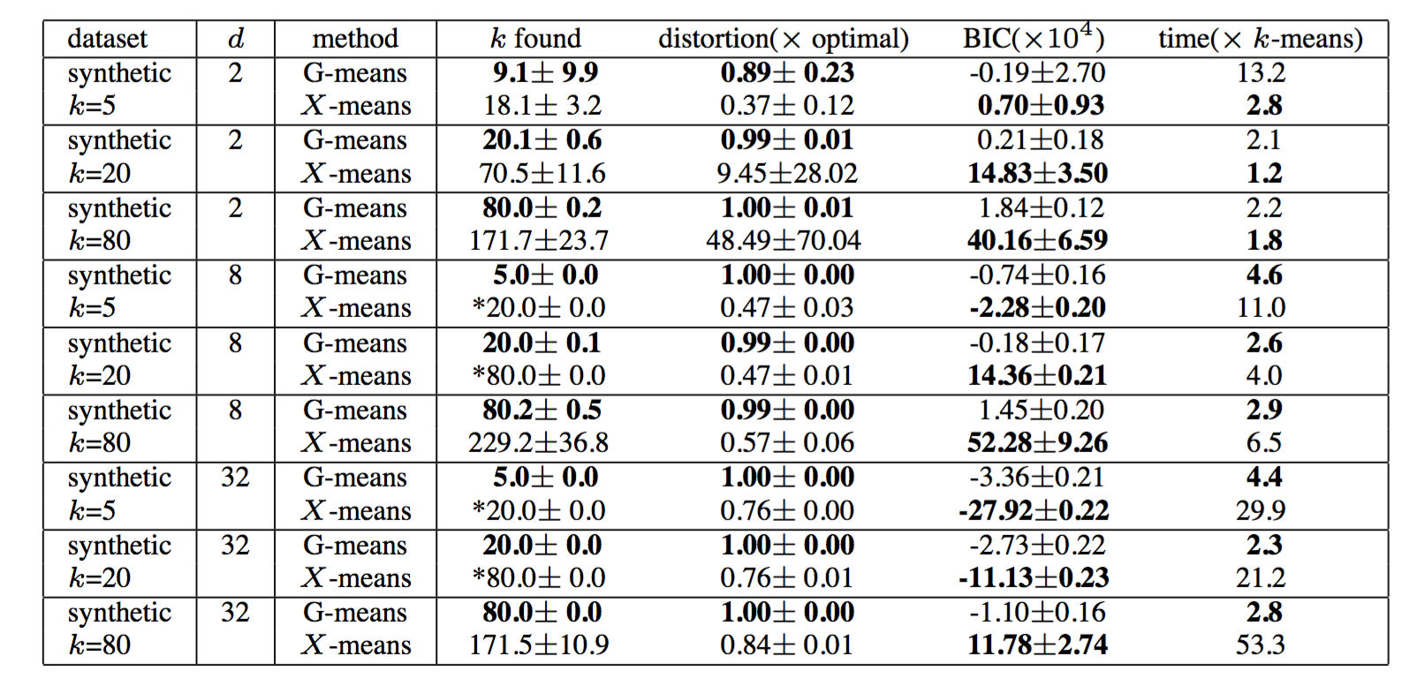

Slide 16
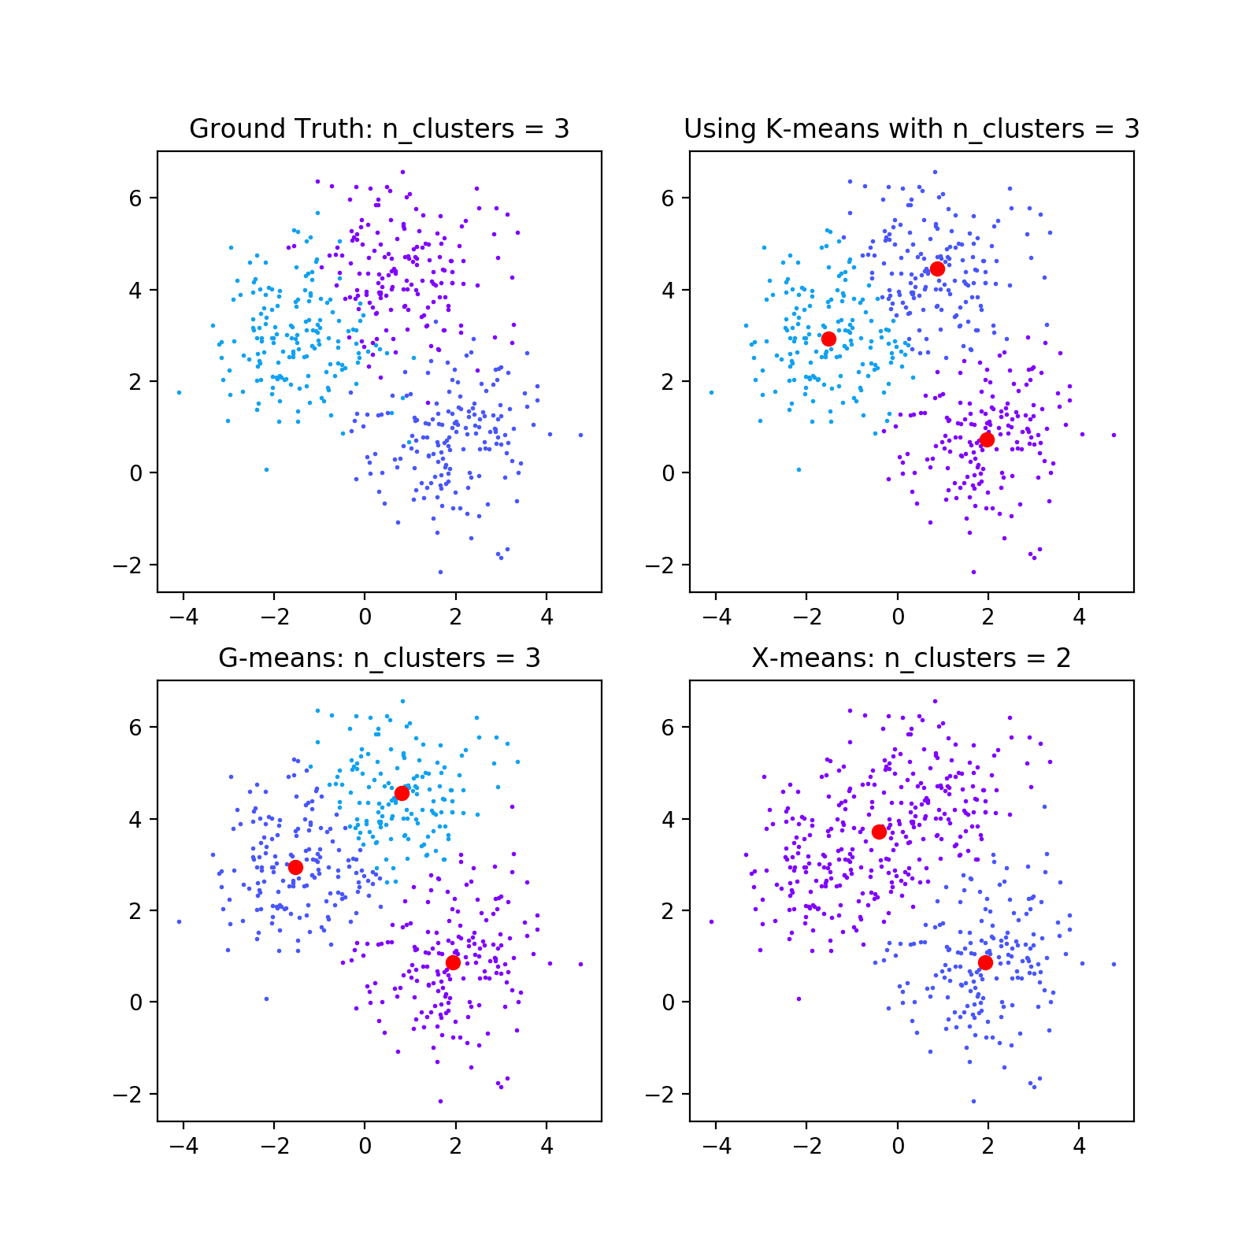
Demonstrate the usefulness of g-means in estimating k
samples = 500
features = 2

Slide 17
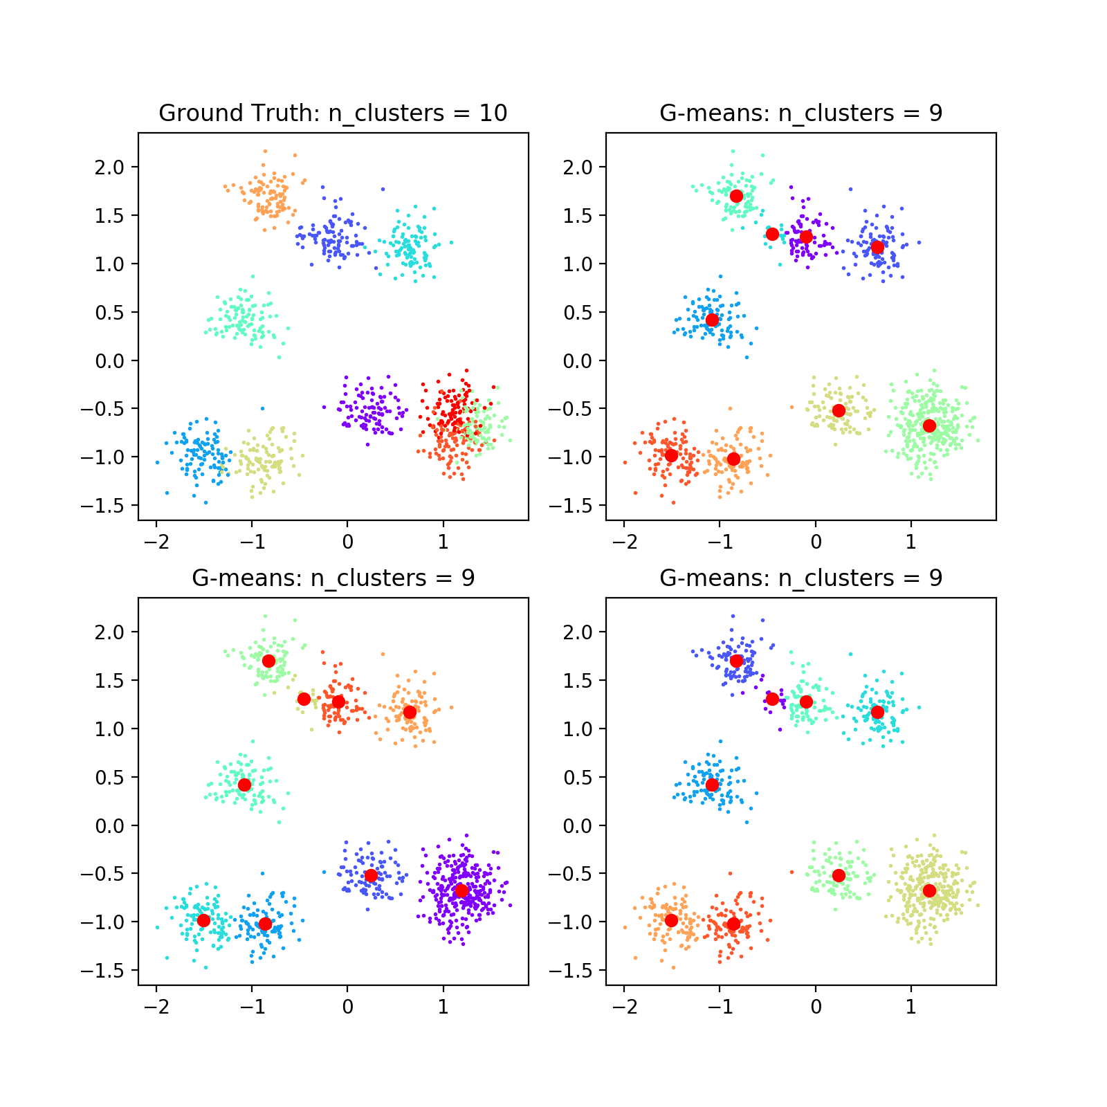
Demonstrate the usefulness of g-means in estimating k
samples = 1000
features = 2
random state = 100

Slide 18
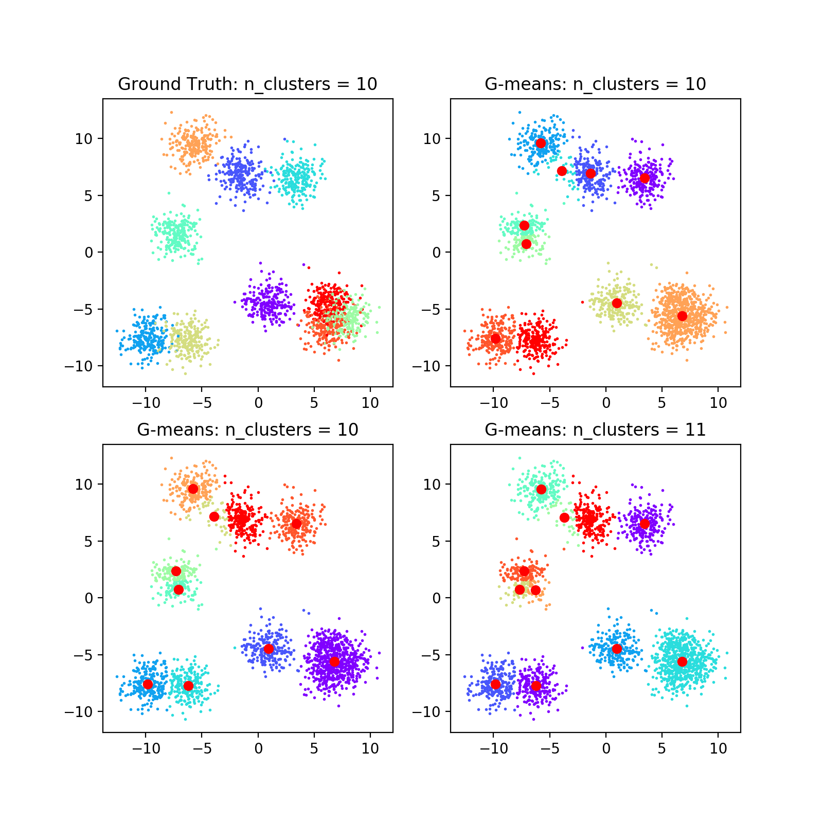
Demonstrate the usefulness of g-means in estimating k
samples = 2300
features = 2
random state = 100

Slide 19
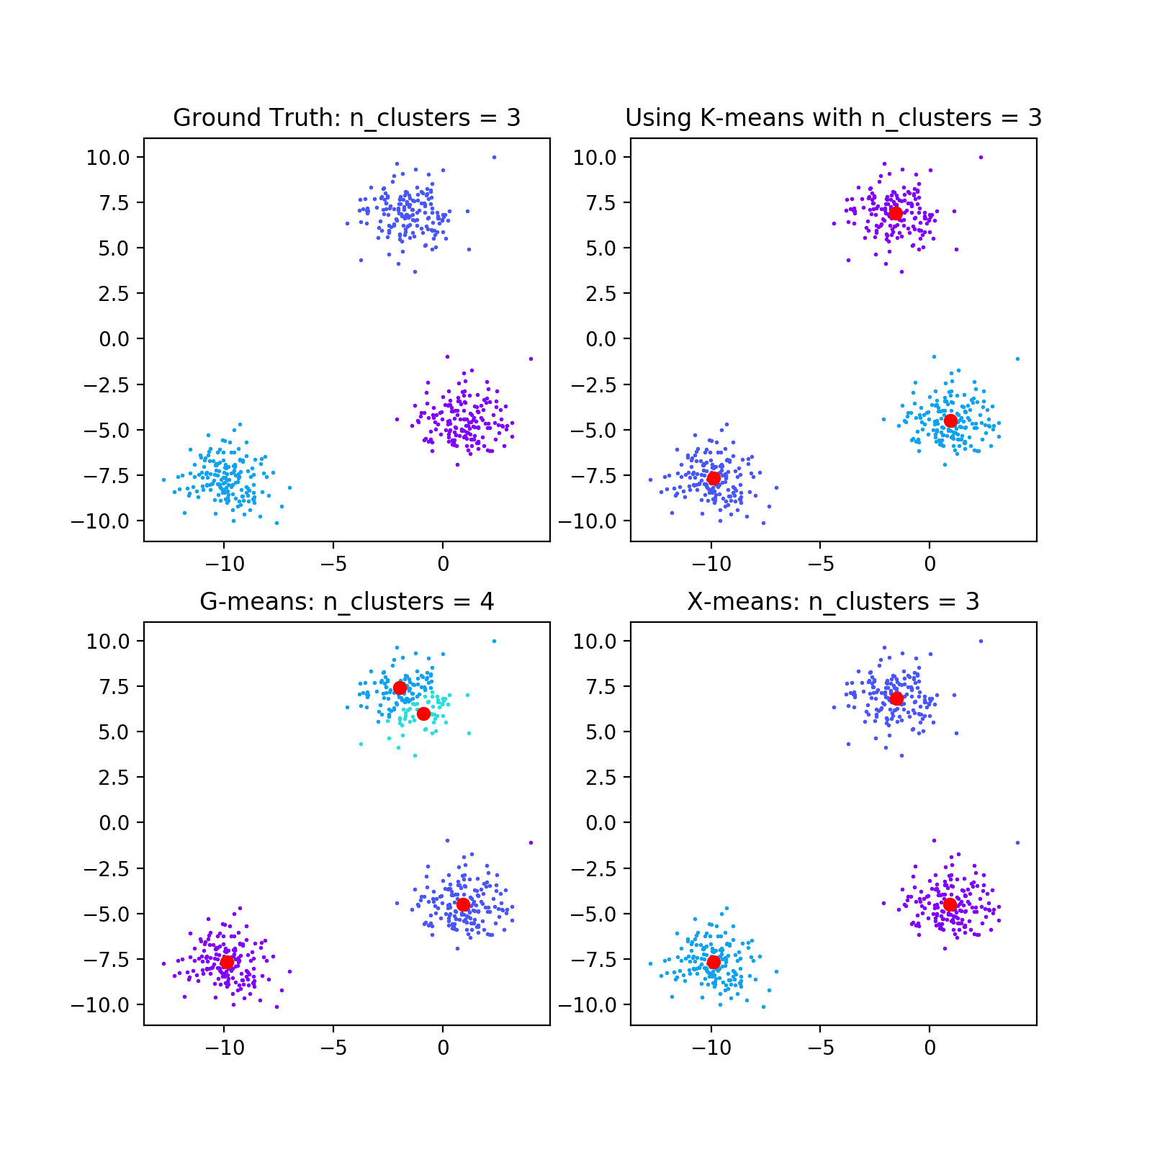
G-means is not accurate
samples = 500
features = 2
random state = 100

Slide 20
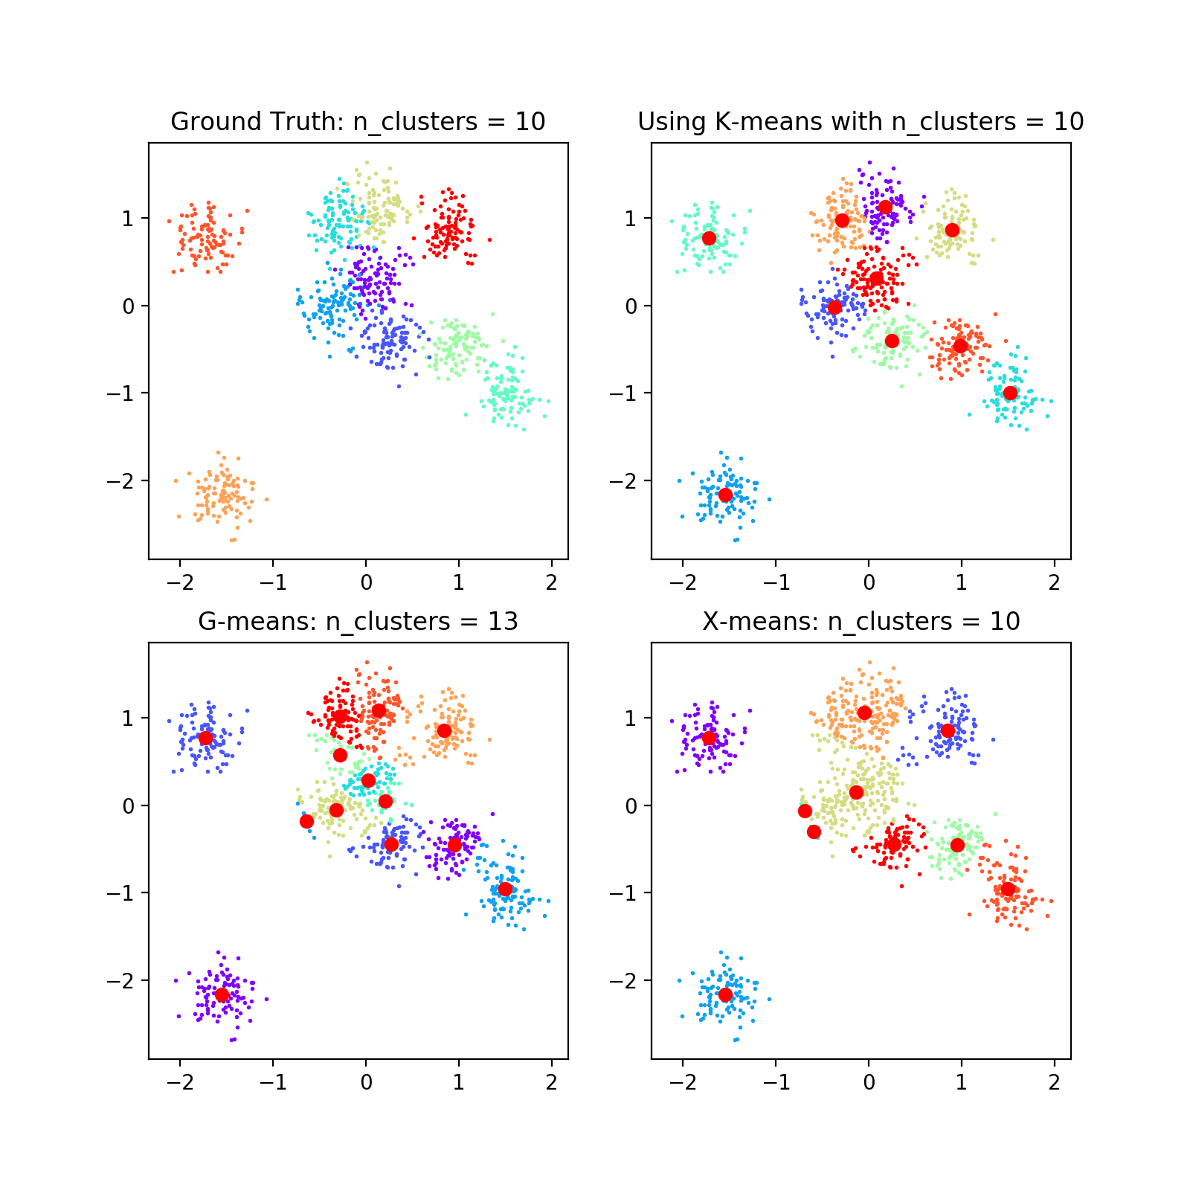
G-means is not accurate: comparing K-means, G-means and X-means
samples = 1000
features = 2
random state = 0

Slide 21
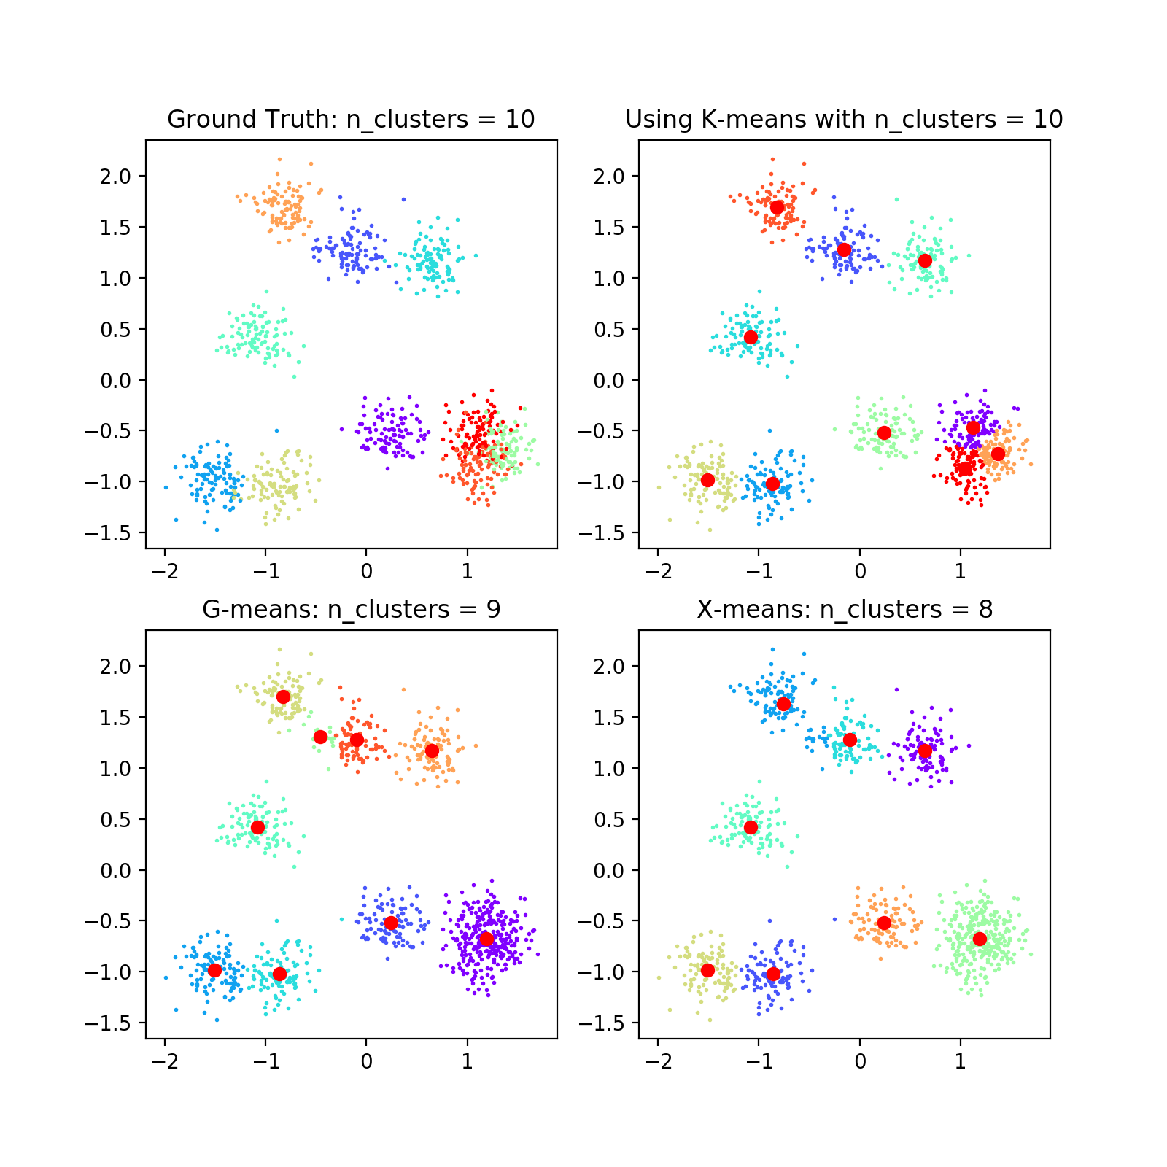
G-means is not accurate: comparing K-means, G-means and X-means
samples = 1000
features = 2
random state = 100

Slide 22
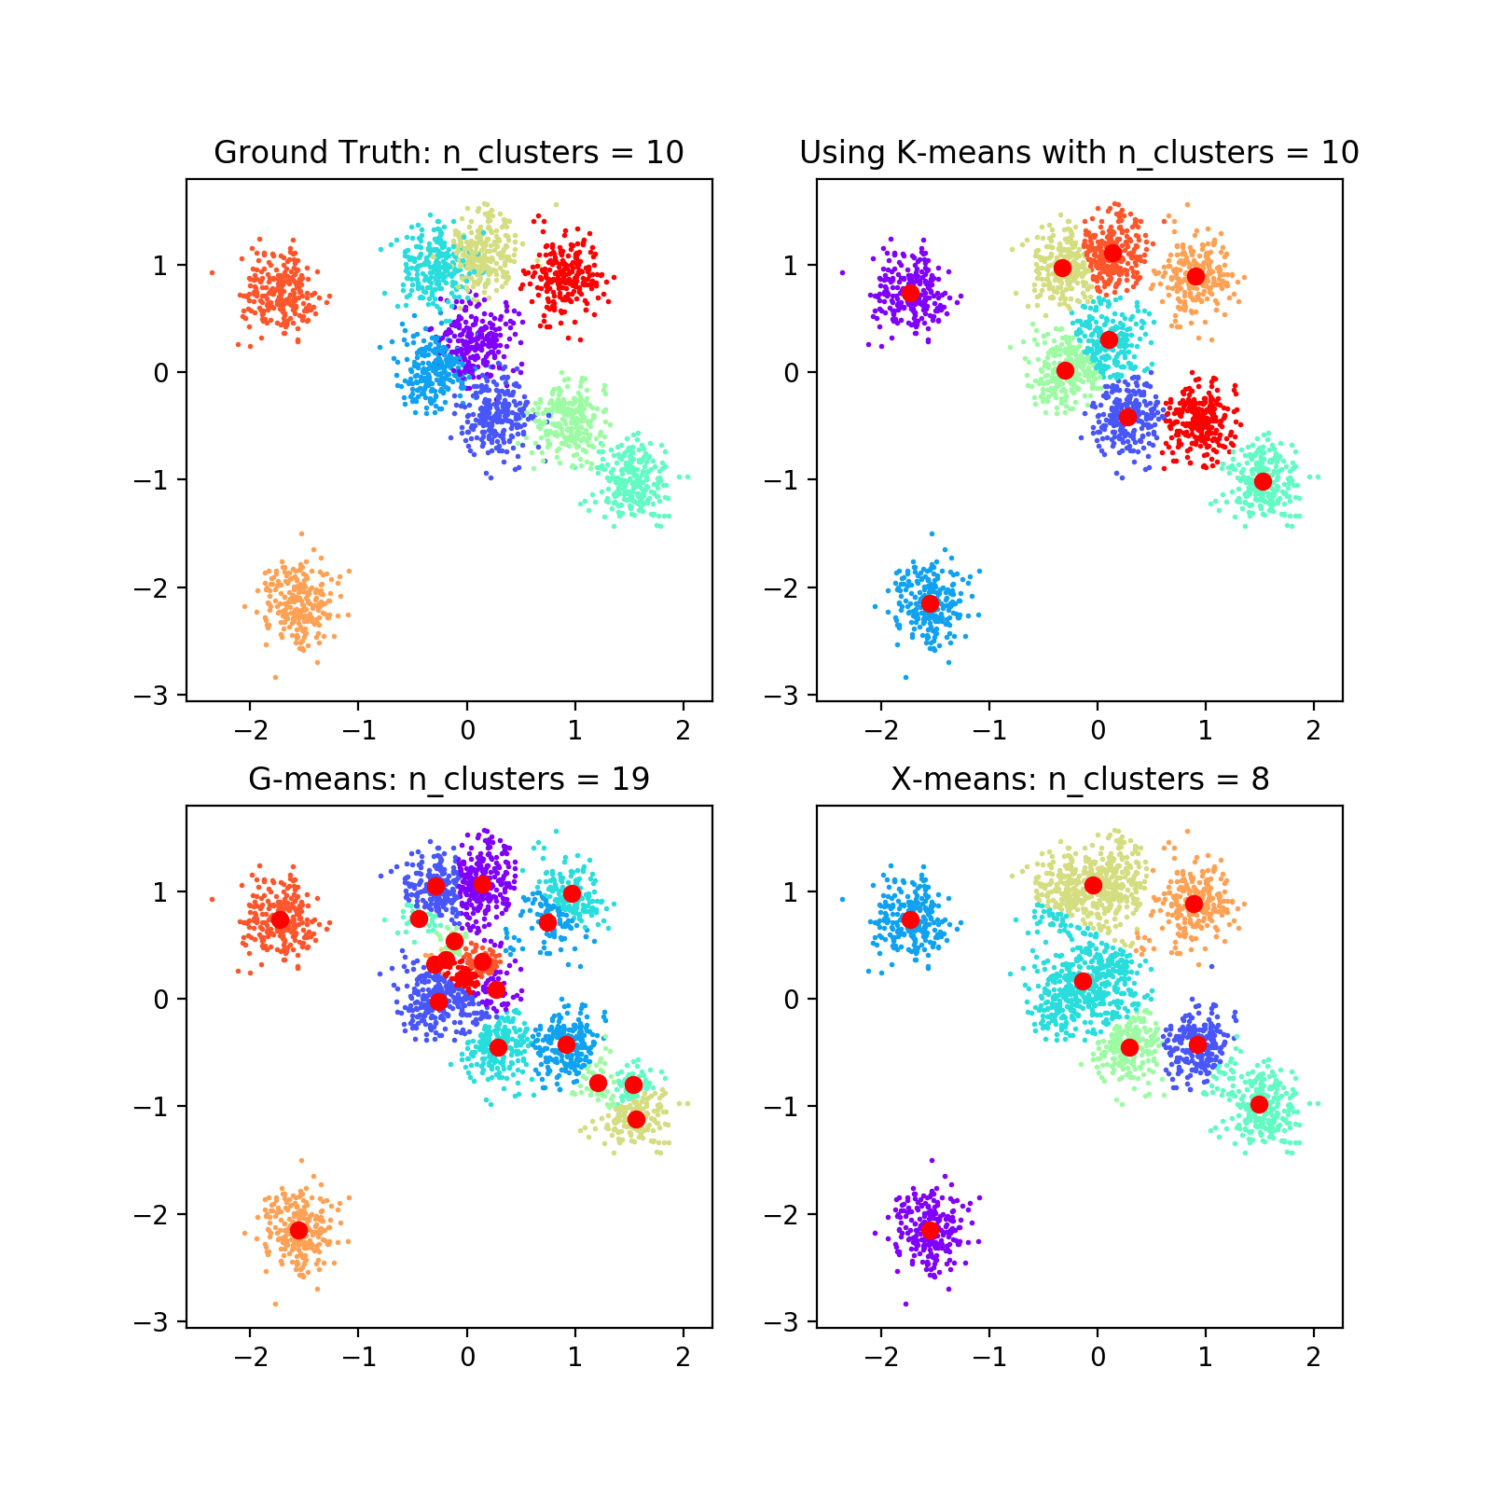
G-means is not accurate: comparing K-means, G-means and X-means
samples = 2300
features = 2
random state = 0

Slide 23
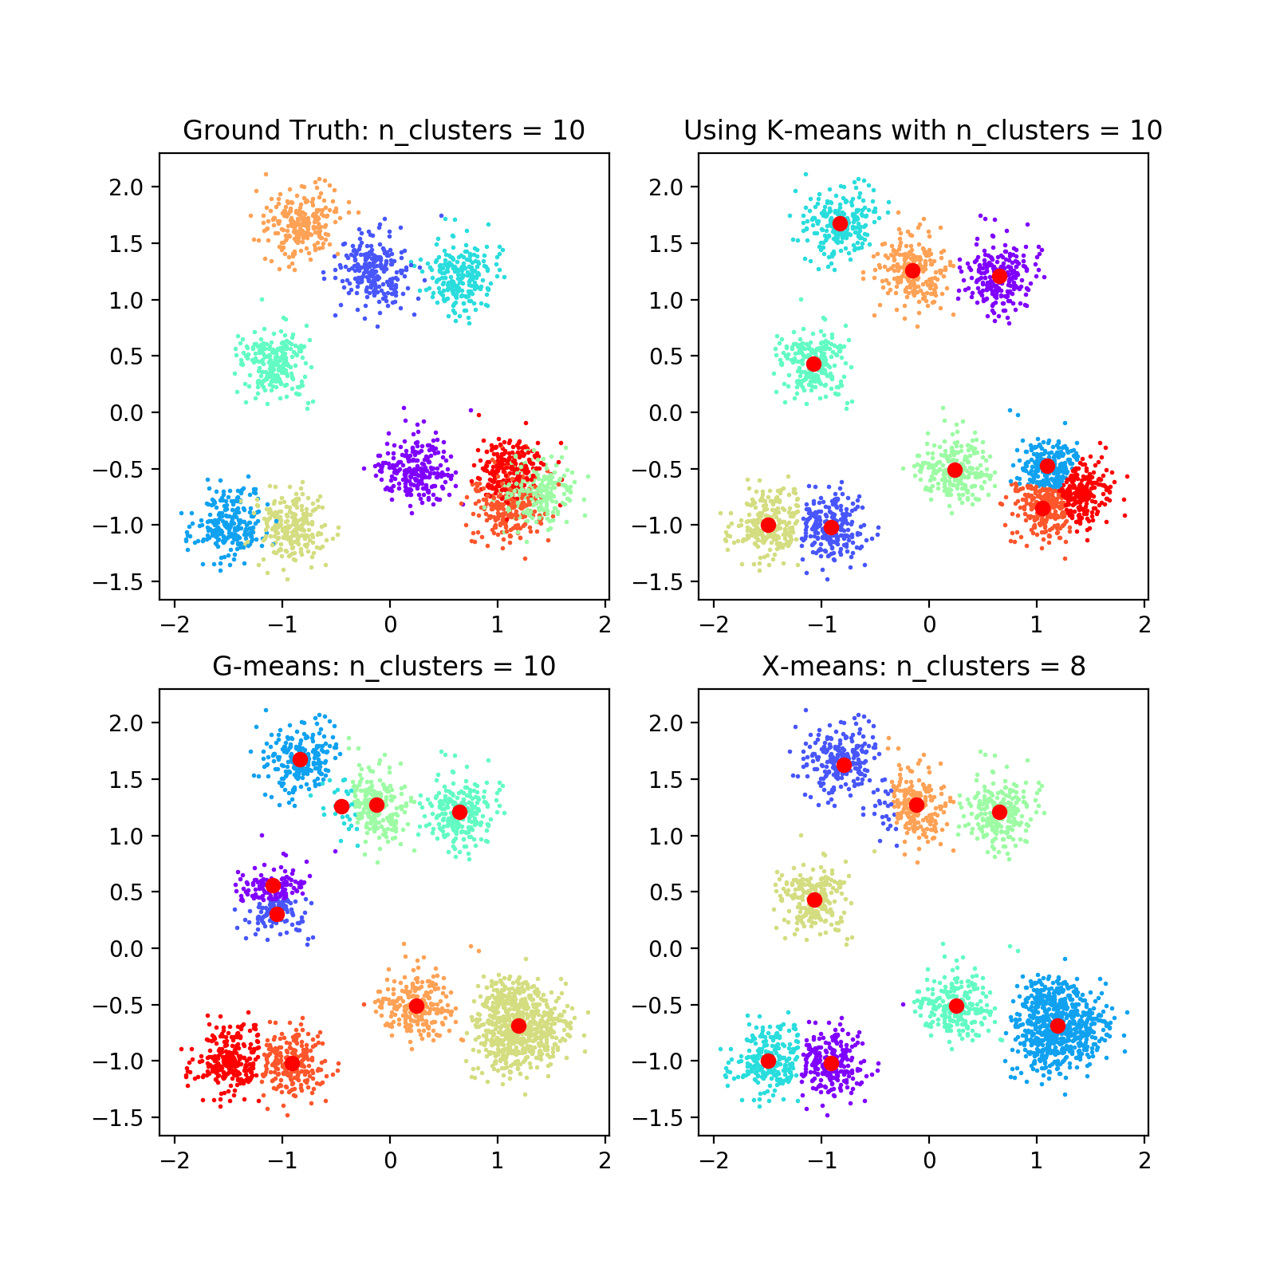
G-means is not accurate: comparing K-means, G-means and X-means
samples = 2300
features = 2
random state = 100

Slide 24
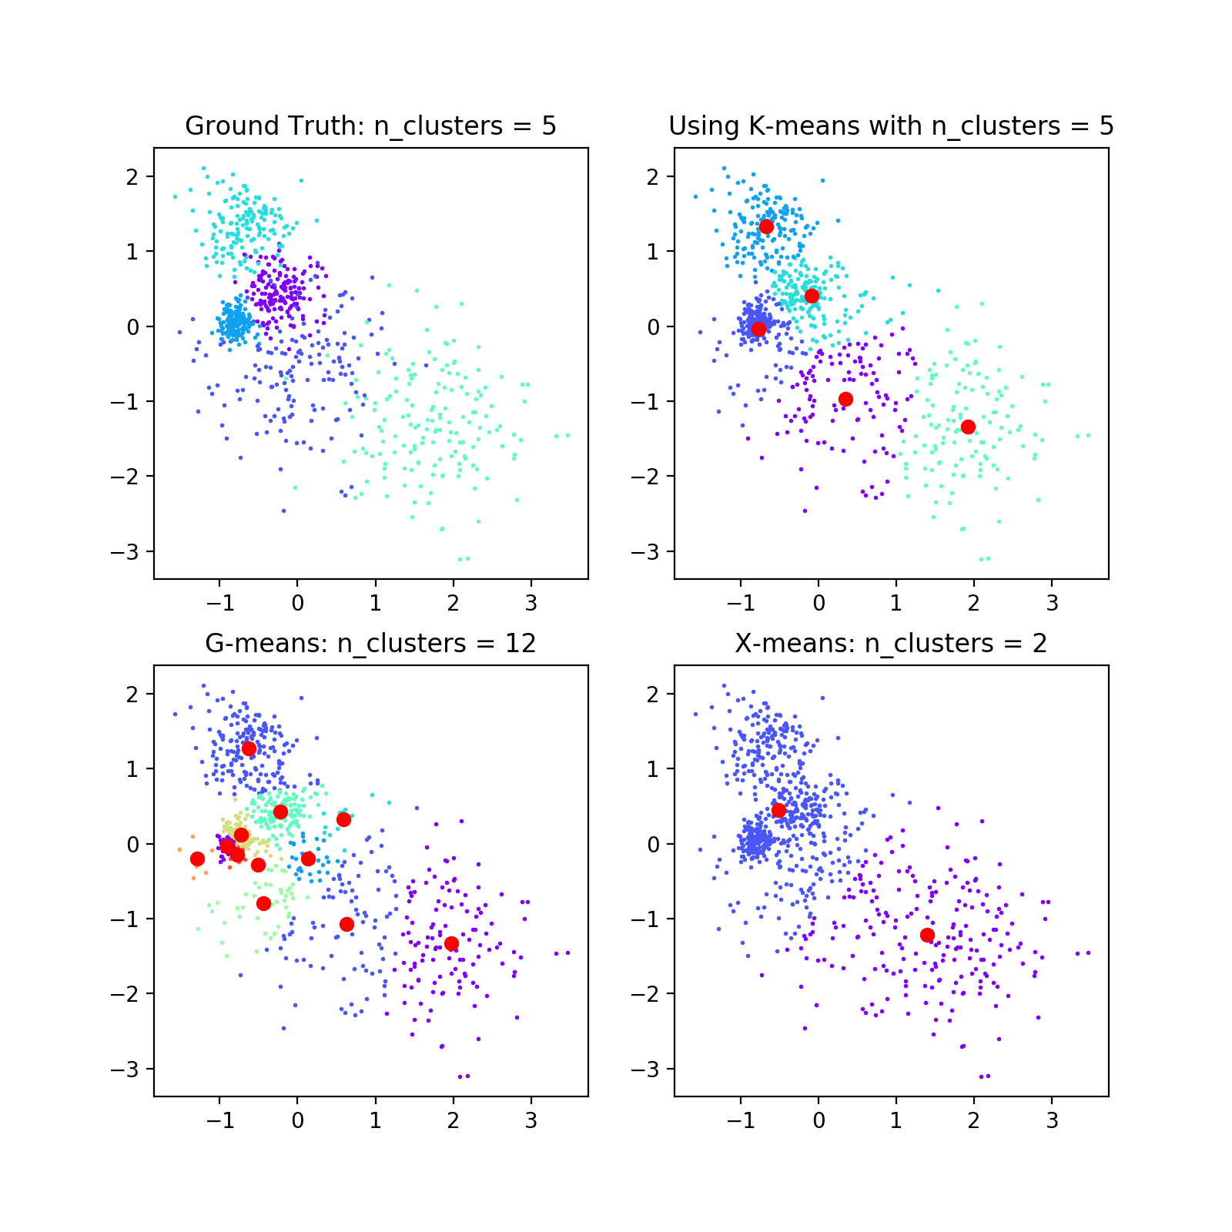
G-means is not accurate: comparing K-means, G-means and X-means
samples = 800
random state = 0

Slide 25
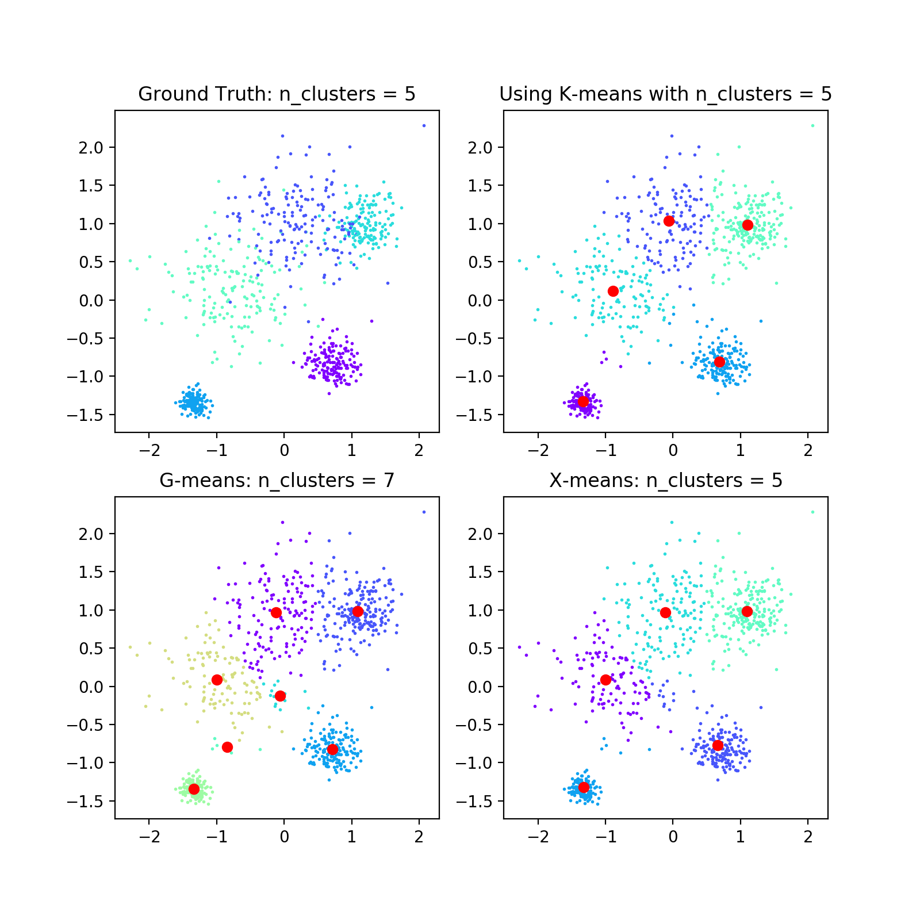
G-means is not accurate: comparing K-means, G-means and X-means
samples = 800
random state = 100

Slide 26
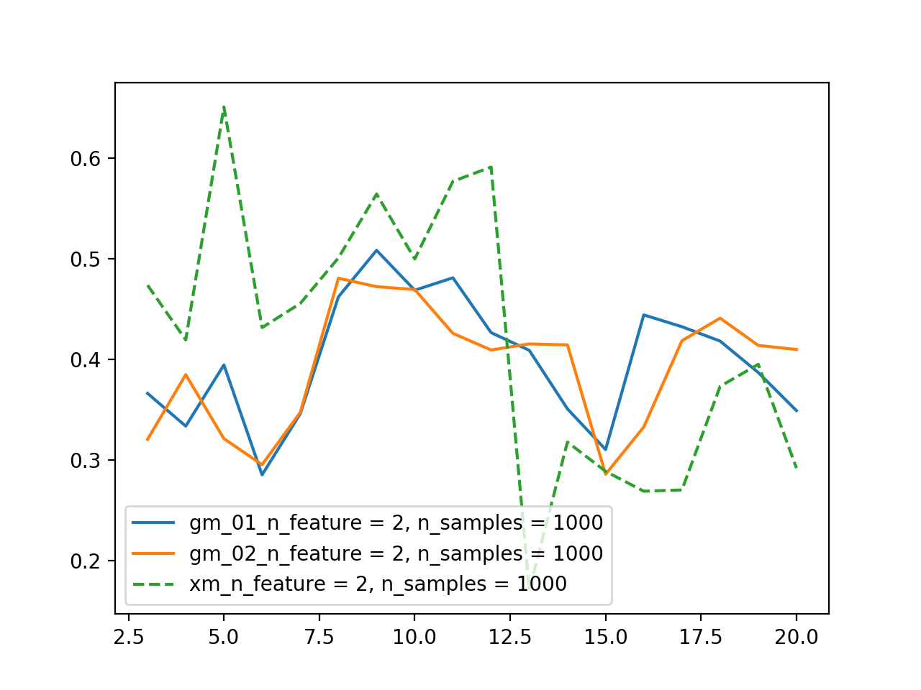
statistical summary
samples = 1000
features = 2
random state = 0

Slide 27
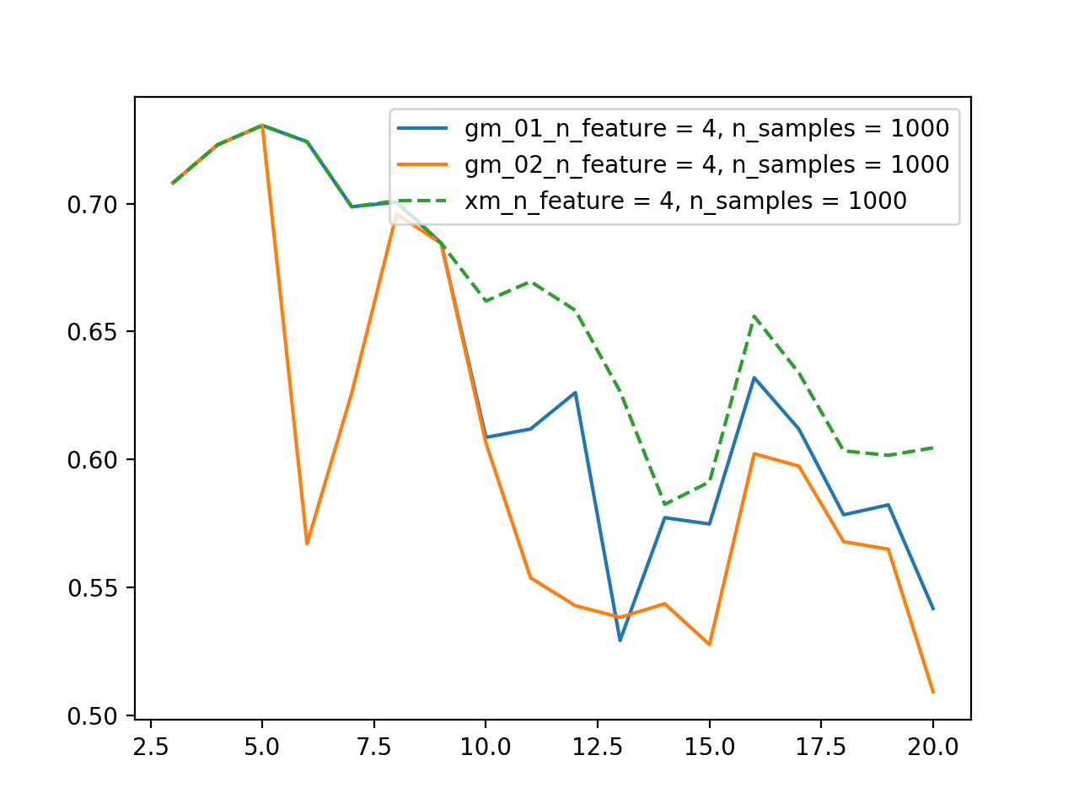
statistical summary
samples = 1000
features = 4
random state = 0

Slide 28
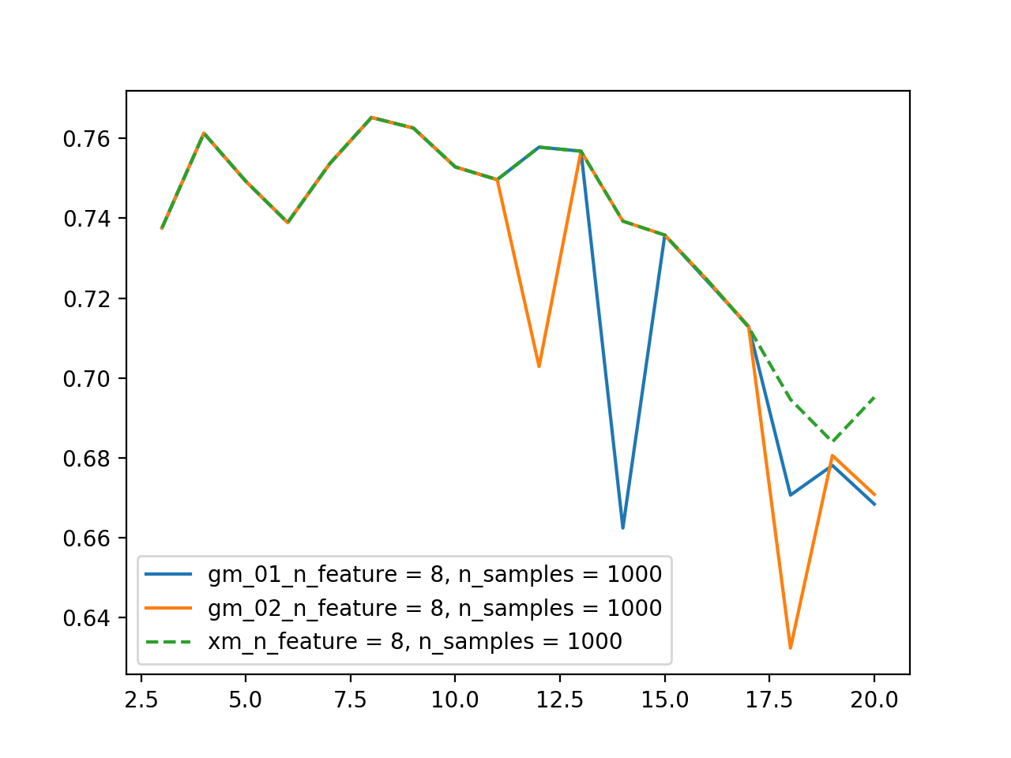
statistical summary
samples = 1000
features = 8
random state = 0

Slide 29
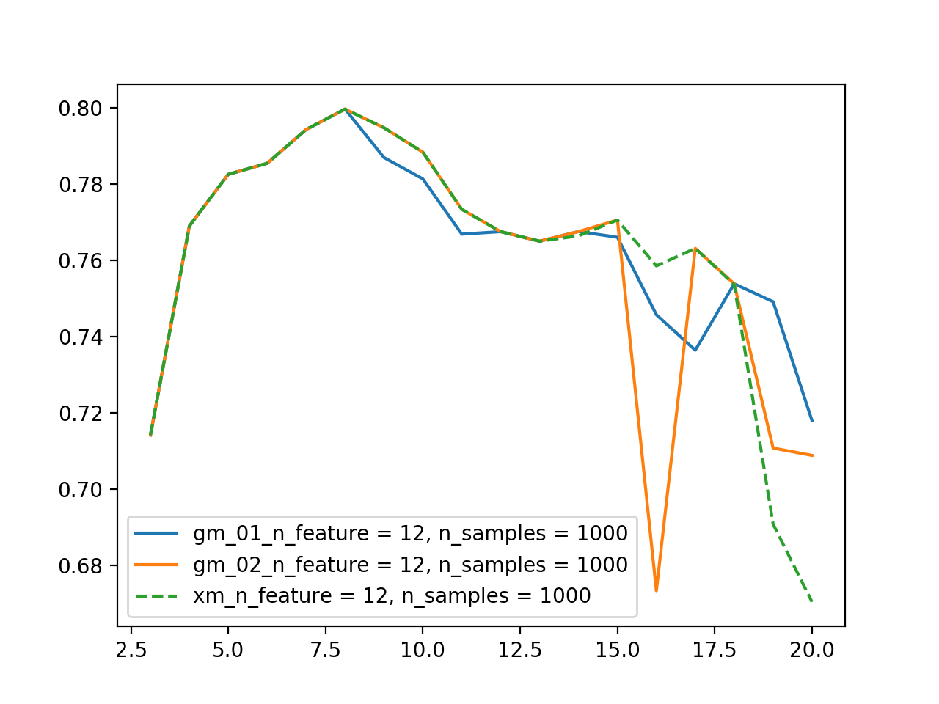
statistical summary
samples = 1000
features = 12
random state = 0

Slide 30
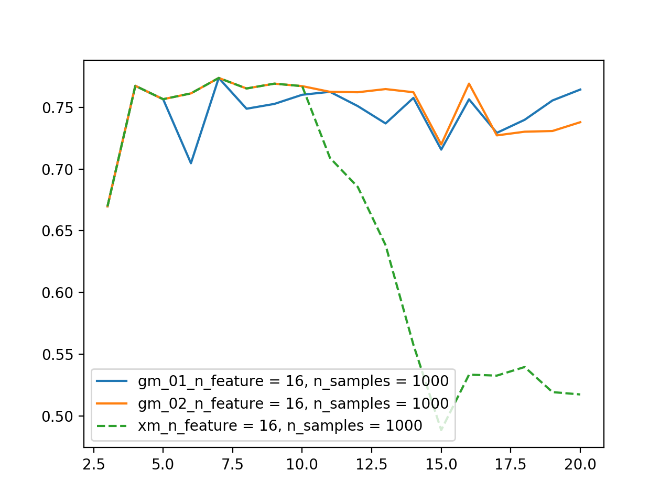
statistical summary
samples = 1000
features = 16
random state = 0

Slide 31
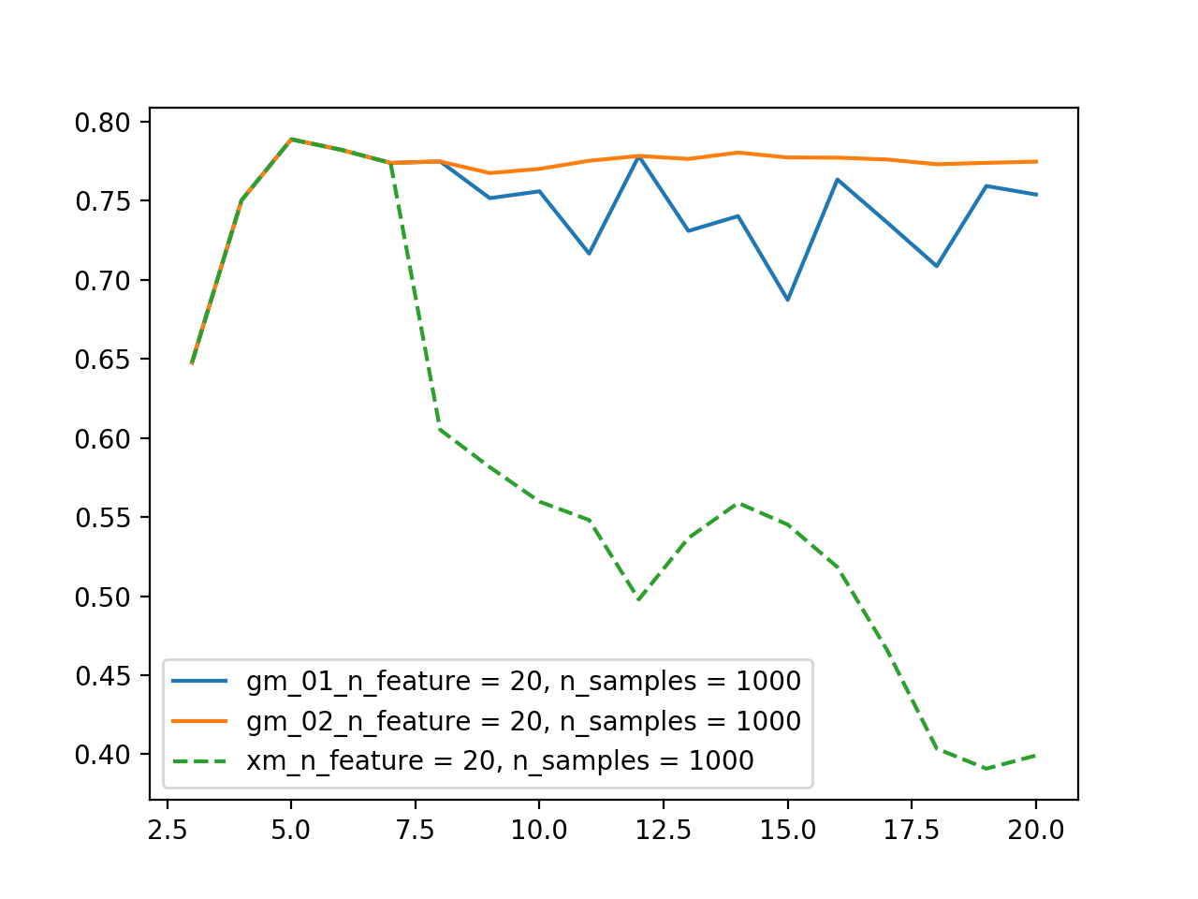
statistical summary
samples = 1000
features = 20
random state = 0

Slide 32
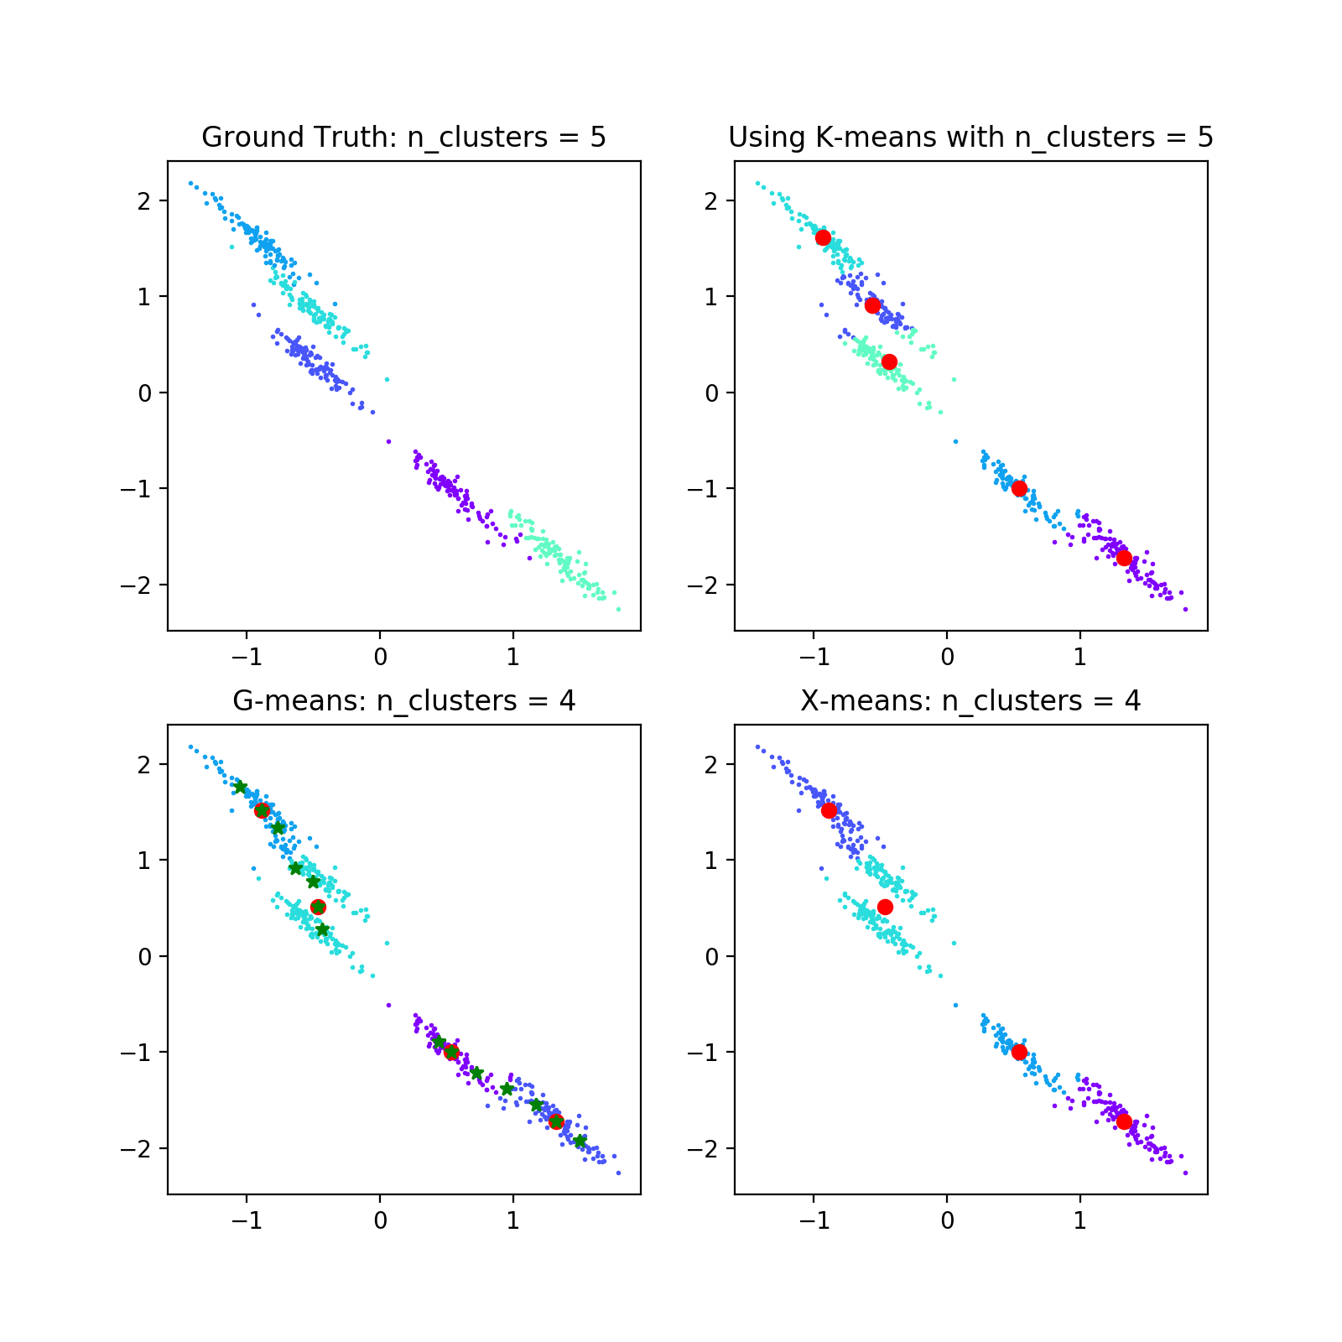
limitation of G-means

Slide 33
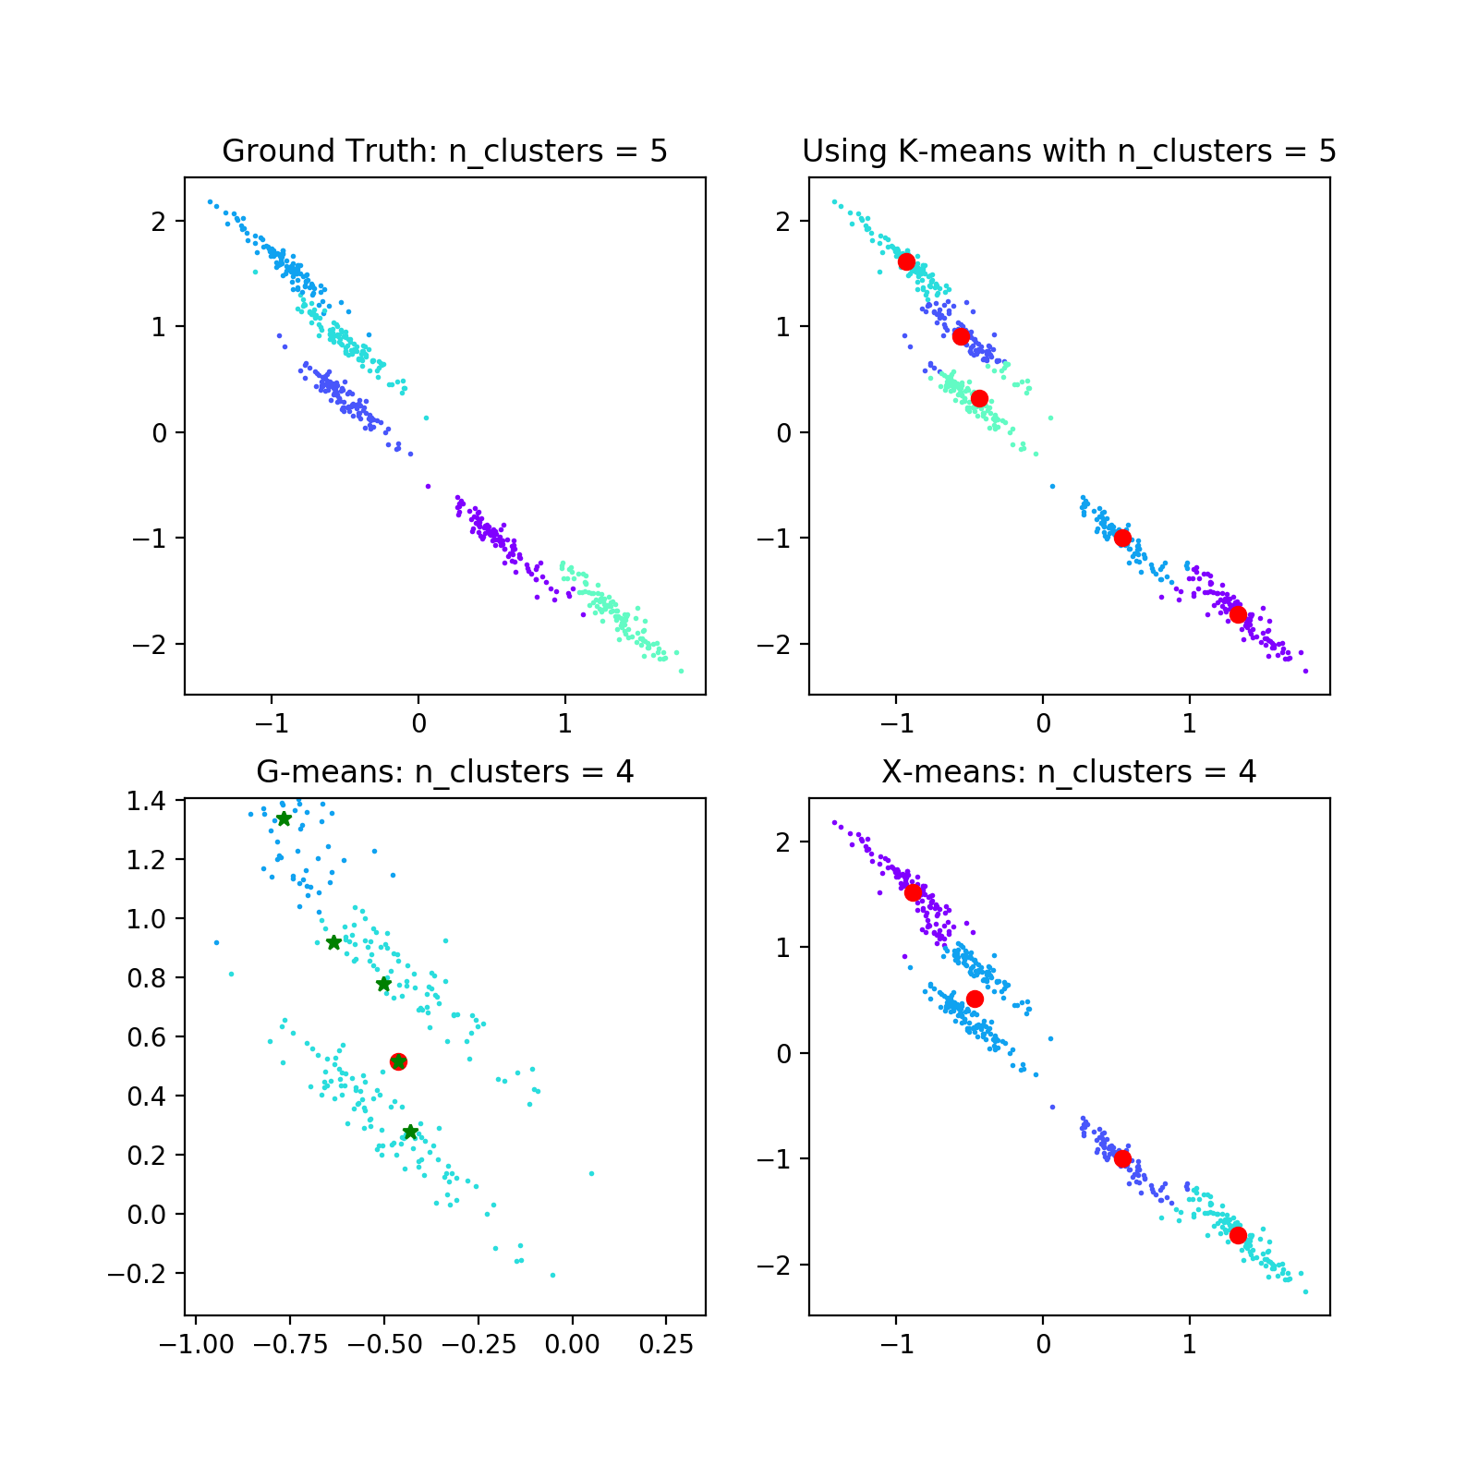
limitation of G-means

Slide 34
Summary
G-means can automatically choose the right k value when data is separated well from each other
G-means cannot perform well when data get crowded together. When that happens, even each cluster is produced by Gaussian distribution, G-means still cannot separate the clusters from each other. It is the inherent limitation from K-means.

Slide 35
References
https://blog.bigml.com/2015/02/24/divining-the-k-in-k-means-clustering/
G. Hamerly and C. Elkan, “Learning the k in k-means,” in Advance in neural information processing systems, pp.281-288,2004

